Slide 1
Assignment Presentation
Probabilistic Graphical Models
Vishnu Prasad P
FT-2017 Batch, Reg. No.: 17ETCS075004
M. Tech. in Machine learning and intelligent systems
Module Leader: Dr. Hariharan Ramasangu
Module Name: Probabilistic Graphical Models
Module Code : MIS503

Slide 2
Marking Scheme
Head | Maximum | Score
Technical Content | 5
Grasp and Explanation | 5
Quality of Slides and Delivery | 5
Q & A | 5
Total | 20

Slide 3
Presentation Outline
Discriminative model is better than generative model in structured classification problems.
Development of an algorithm to extract syntactic cues and semantic labels from a narrative text such that they form an input to knowledge representation module.
Development of an algorithm for action description of a narrative text using Bayesian network.

Slide 4
Generative model is better than discriminative model in structured classification problems
Application : Structured Classification Problem in Natural Language Processing.
Need:
Probability estimates can be smoothed to accommodate unseen events
Redundancy in language supports effective statistical inference procedures \ the stimulus is richer than it might seem.
Statistical learning theory: generalization ability of a model class can be measured independently of model representation.

Slide 5
Advantages and disadvantages of Generative and Discriminative models
Discriminative models do not offer clear representations of relations between features and classes in the dataset.
Generative models often outperform discriminative models on smaller datasets because their generative assumptions place some structure on your model that prevent overfitting.
Stance: Discriminative models are more powerful than the generative models and hence work better for larger datasets than smaller datasets. The only problem is of Overfitting in smaller Datasets.

Slide 6
Develop an algorithm to extract syntactic cues and semantic labels from a narrative text such that they form an input to knowledge representation module.
Tokenizationof the narrative text.
The narrative text is tokenised into two forms word and sentences.
Sentence tokenization output:
['One day Buddha was walking through a village.', 'A very angry and rude young man came up and began insulting him.', '“You have no right teaching others,” he shouted.', '“You are as stupid as everyone else.’]
Word tokenization output:
['One', 'day', 'Buddha', 'was', 'walking', 'through', 'a', 'village', '.', 'A', 'very', 'angry', 'and', 'rude', 'young', 'man', 'came', 'up', 'and', 'began', 'insulting', 'him', '.', '“', 'You', 'have', 'no', 'right', 'teaching', 'others', ',', '”', 'he', 'shouted', '.', '“', 'You', 'are', 'as', 'stupid', 'as', 'everyone', 'else’]

Slide 7
Develop an algorithm to extract the syntactic cues from the text
Read text.
Identify the Special Characters and flag them(Not included for POS tagging)
Creation of the dictionary the only picks the required words
Words that starts with the Noun=>Adjective=>Noun
Words ending (Leaf Ending) which has a conjunction as parent.
Perform tokenisation eliminating the special characters.
Run through parts of speech tagger.
With the help of the dictionary only select the words that fit into and print.

Slide 8
Develop an algorithm to extract the syntactic cues from the text
Output:
Sentence 1
day
buddha
village
Sentence 2
rude
young
man
Sentence 3
right
teach
other
Sentence 4
everyone
Sentence 5
nothing
fake
buddha
insult
Sentence 6
young
man
tell
gift
someone
person
gift
belong
man
strange
question
Sentence 7
gift
buddha
anger
anger

Slide 9
Formation of a semantic label table
Semantics is the meaning of words in sentences. it refers to meaning that does not depend on the context where it appears. Semantic table consists of [Context1, Intent1, Dependencies, Dep].Context has the words in the sentence ,Intent represents to the Action that is performed in the sentence, Dependencies represents the dependence of other words in the same sent to the word in the context, Dep is the semantic role label.
0 One day [] nummod
1 day walking [One] npadvmod
2 Buddha walking [] nsubj
3 was walking [] aux
4 walking walking [day, Buddha, was, through, .] ROOT
5 through walking [village] prep
6 a village [] det
7 village through [a] pobj
8 . walking [] punct

Slide 10
Development of an algorithm to extract the semantic labels
Algorithm:
Read text.
Tokenize the paragraph into sentences.
Identify the ‘and’ and ‘also’ words in the input and combine if wrongly tokenised in tokenisation.
Links between the words are identified.
The word with maximum links is the word that contains the action(Meaning) of the sentences.
The root word is extracted from the whole sentence.

Slide 11
Development of an algorithm to extract the semantic labels
Sentence 1 | Walking
Sentence 2 | Angry, Came, Began
Sentence 3 | Shouted
Sentence 4 | Are Stupid
Sentence 5 | Are Fake
Sentence 6 | Take, gift, Buy, Belong
Sentence 7 | Falls, Anger

Slide 12
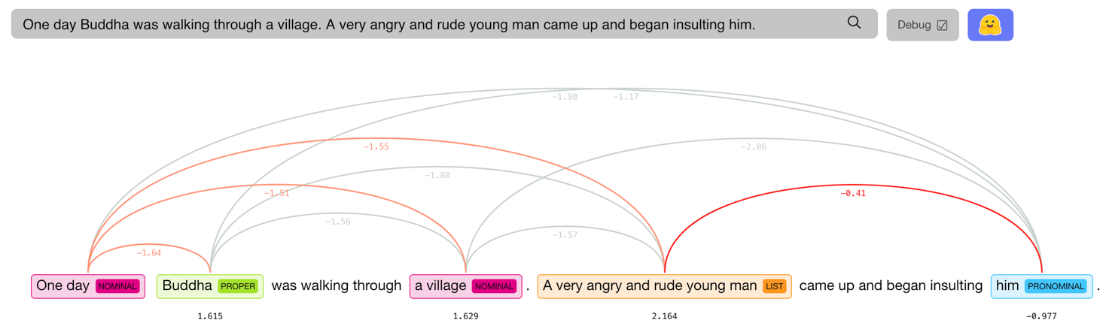
Development of an algorithm for coreference resolution for the extracted syntactic and semantic information
Coreference resolution is the task of determining linguistic expressions that refer to the same real-world entity in natural language.

Slide 13
Feature identification by integrating syntactic, semantic, and coreference information.
Each every step that is achieved until now has given some important information for further processing to be precise with the information contributed by the individuals are as follows.
Syntactic Extractor: Base words that form the story.
Semantic Extractor: Main Theme of the sentence.
Coreference resolution: Relationship between linguistic expression and real world word.

Slide 14
Develop an algorithm for action description of a narrative text using Bayesian network.
Development of a knowledge representation algorithm using the features identified in Part-B.
The actual story the main context of the story lies in the conversation of Buddha and the young Man.
The part before the conversation tells the thinking of the young man about Buddha.
The Conversation refers to the Intent call gift but ultimately it is referred to the anger and the hurt.
The complete reference to gift has to be taken to the Anger and Hurt.

Slide 15

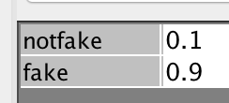

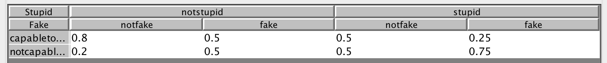
Identification of threshold patterns for joint probability distribution

Slide 16
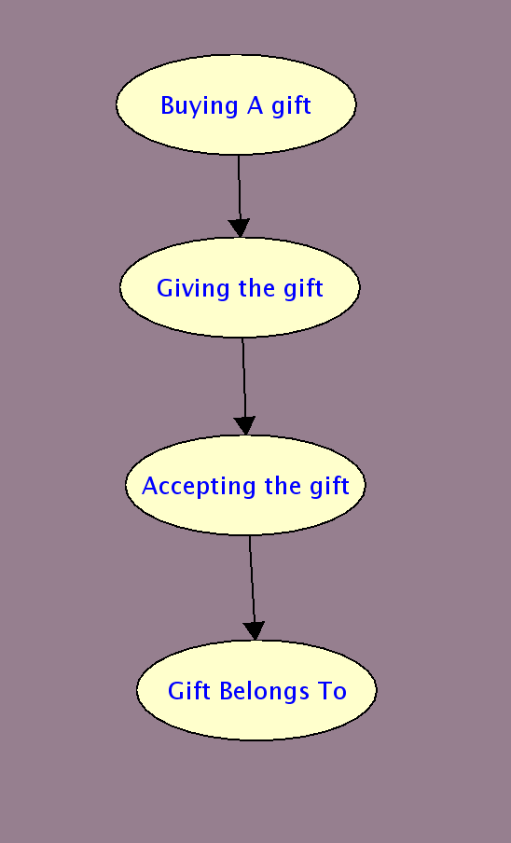
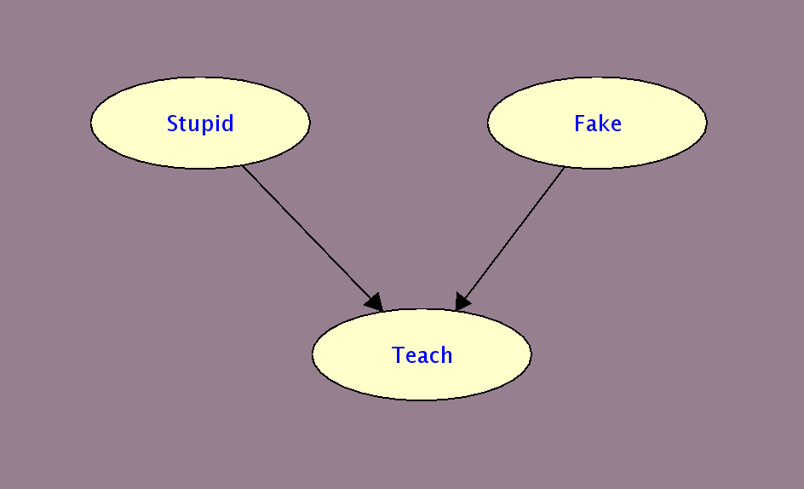
Development of a Bayesian network model
As the story is seen in perspective of two parts I.e.
Before conversation
While conversation

Slide 17
Development of a reasoning scheme for inferring action description
Reasoning scheme for inferring the action is done using the python library for probabilistic graphical model pgmpy.
OUTPUT
q = storybeforeconv_model.query(variables=['Teach'], evidence={'Stupid': 0})print(q['Teach'])
+------------+--------------+
| Teach | phi(Stupid) |
|-------------+--------------|
| Teach_0 | 0.7000 |
| Teach_1 | 0.3000 |
+------------+--------------+

Slide 18
Analysis of results and comment on the influence of representation, inference, and learning algorithm
Computing the probability of teaching given stupid.
+------------+--------------+
| Teach | phi(Stupid) |
|-------------+--------------|
| Teach_0 | 0.7000 |
| Teach_1 | 0.3000 |
+------------+--------------+
Looking at the above result it clearly made an inference of if the person is stupid there is no point of him teaching.
In this model the inference of the anger and is directly obtained it is from the Knowledge representation only.
Similarly as given all the inference can be made from the above graphical models.

Slide 19
References
Xavier Carreras and Lu´ıs Marquez. 2005. Introduction to ` the CoNLL-2005 shared task: Semantic role labeling. In Proceedings of CoNLL.
Eugene Charniak and Mark Johnson. 2005. Coarse-to-fine n-best parsing and MaxEnt discriminative reranking. In Proceedings of ACL.
Eugene Charniak. 2000. A maximum-entropy-inspired parser. In Proceedings of NAACL, pages 132–139.
Michael Collins and James Brooks. 1995. Prepositional attachment through a backed-off model. In Proceedings of the Third Workshop on Very Large Corpora, pages 27– 38. Michael Collins. 1997. Three generative, lexicalised models for statistical parsing. In Proceedings of ACL, pages 16 – 23. Michael Collins. 2000. Discriminative reranking for natural language parsing. In Proceedings of ICML, pages 175– 182.

